Slide 1


Computed Torque Controller for Motion Control of a 6 DOF Industrial Robot Manipulator
By:
Aniketh Reddy Seelam (aseelam@wpi.edu)
Marlon Scott (mscott@wpi.edu)

Slide 2
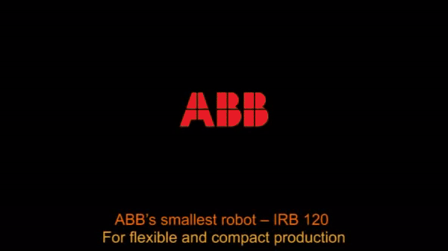
Contents
Introduction
Problem Description
Methodology
Kinematics
Dynamics
Control Law
Results
Graphs
Simulation
Conclusion

Slide 3
Introduction
Motion Control of Industrial Robots is paramount for various applications.
Industrial Robots software packages are limited.
Use knowledge learnt in the course and existing tools to control a 6 DOF robot.
Kinematics, Dynamics and Control Law developed to understand the fundamentals aspects of a robotic system.
Need to establish communication between two independent and powerful softwares.

Slide 4
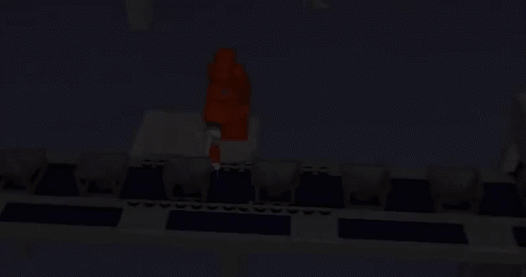
Problem Description
Perform Motion Control of ABB IRB 120 Industrial Robot Manipulator to follow a rectangular trajectory.
Establish communication between MATLAB and RobotStudio to visualize the results of the controller.

Slide 5
Methodology
Solve:
Kinematics
Forward Position Kinematics
Inverse Position Kinematics
Forward Velocity Kinematics
Inverse Velocity Kinematics
Dynamics
Forward Dynamics
Inverse Dynamics
Control
Computed Torque Control
Communication between MATLAB and RobotStudio

Slide 6
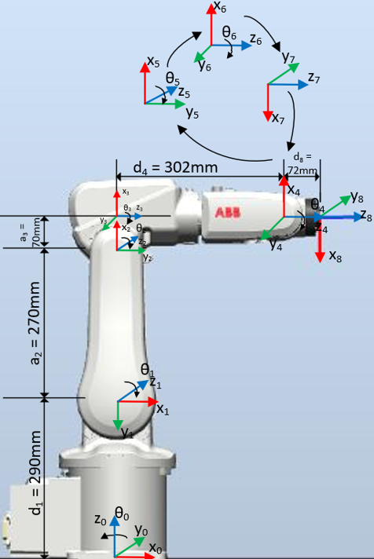
KInematics
Forward Position Kinematics
Calculation of the position and orientation of the end-effector frame from the joint angles.
Using Denavit-Hartenberg parameters.
Transformation | theta(deg) | d(mm) | alpha(deg) | a(mm)
T01 | theta_1 | 290 | -90° | 0
T12 | theta_2 - 90° | 0 | 0° | 270
T23 | theta_3 | 0 | -90° | 70
T34 | 0° | 302 | 0° | 0
T45 | theta_4 | 0 | 90° | 0
T56 | theta_5 | 0 | -90° | 0
T67 | theta_6 + 180° | 0 | 0° | 0
T78 | 0° | 72 | 0° | 0
DH Table for ABB IRB 120
IRB 120 Coordinate Frames

Slide 7
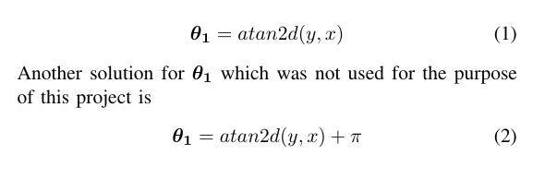
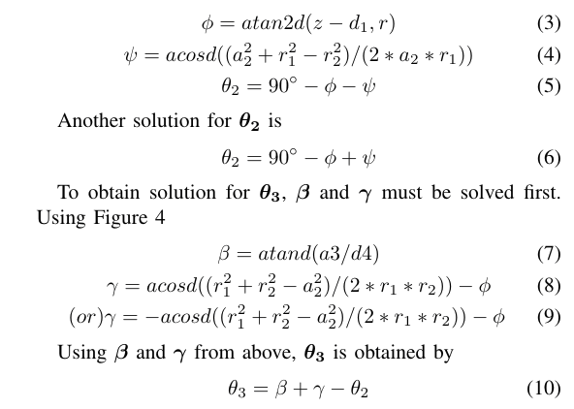

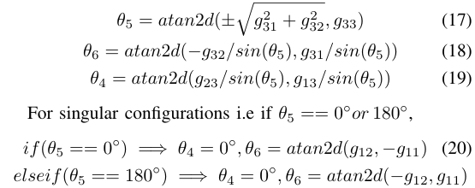
kINEMATICS
Inverse Position Kinematics
Obtain the joint configuration(s) which places the robot's end effector at the desired end effector position and orientation.
One-many solution most of the times.
Pieper's Solution.
Top View of Stick Model
Side View of Stick Model

Slide 8
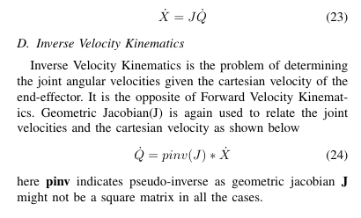
kinematics
Forward Velocity Kinematics
Determine the cartesian velocity of the end-effector given the angular velocity of the joint angles.
Related by Geometric Jacobian.
Inverse Velocity Kinematics
Determine the joint angular velocities given the cartesian velocity of the end effector.
Related by Geometric Jacobian.
Notes:
After calculating the solution for the Forward and Inverse Position Kinematics, we determined the cartesian velocity of the end-effector, given the computed angular velocity. This is calculated using the application of the geometric Jacobian. Conversely, we calculated the joint angular velocities given the cartesian velocity, using the application of the pseudo-inverse of the geometric Jacobian.

Slide 9
Dynamics
Solved using MATLAB Robotics Toolbox¹ due to the complexity of the robot.
Forward Dynamics²
Calculate the joint accelerations given the joint torques and states.
Method to compute mass matrix is also available⁴.
jointAccel = forwardDynamics(robot,configuration,jointVel,jointTorq)
H = massMatrix(robot,configuration)
Inverse Dynamics³
Calculate the joint torques required to perform the given motion.
jointTorq = inverseDynamics(robot,configuration,jointVel,jointAccel)
Notes:
We leveraged MATLAB’s Robotics System Toolbox to assist in the calculation of our forward and inverse Dynamic solution. Using the forward dynamics function available in the Toolbox, we were able to calculate the joint accelerations, given the joint torques and states. Using the inverse dynamics function, we were able to calculate the joint torques of the robot required to perform the desired motion.

Slide 10
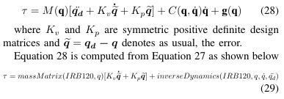
Control law
Module to ensure the robot follows the commands given by the user.
Computed Torque Control
Based on the feedback linearization principle which is an approach that maps a nonlinear model into a linear closed-loop equation in terms of the state variables.
Choice of the design parameters of the controller is trivial.
Control Law:
Close the Loop
Notes:
We decided to implement a Computed Torque controller to control our robot’s motion. The Computed Torque Controller is based on the feedback linearization principle, which maps a non-linear model into a linear closed-loop equation in terms of the state variables. The choice of the design parameters is trivial. Here we show the Computed Torque Control Law, as well as the equation for the torque , tau, when the control loop is closed with the state-space equation.

Slide 11
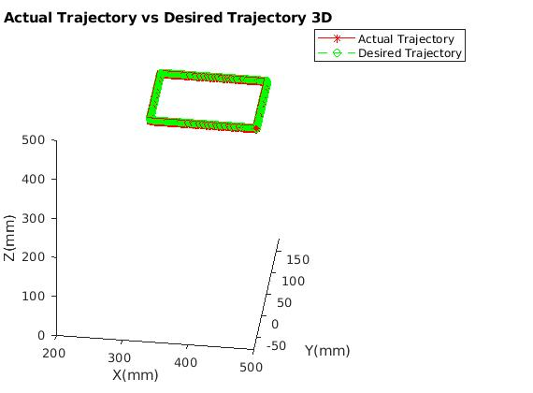
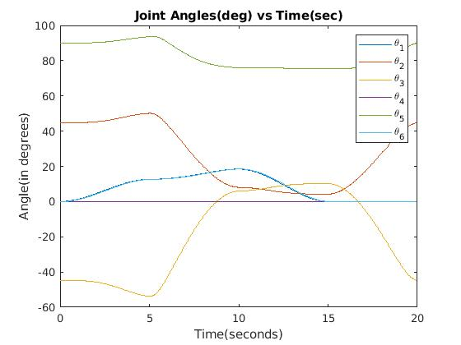
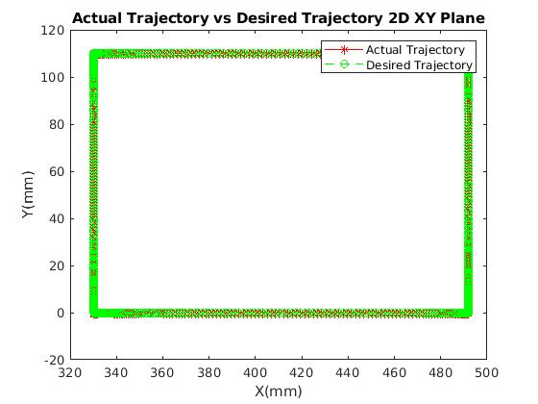
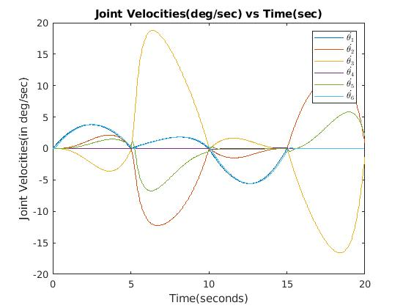
Results
Actual vs Desired Trajectory
Joint Angles and Joint Velocities
Notes:
Here, we illustrate a series of plots demonstrating our results. The two slides on the left show our actual vs desired trajectory in the 3-D and 2-D planes. We see that the end-effector very closely matched our desired trajectory. On the right, we see a plot of our joint angles’ position and velocities. We can also observe that the joint velocities of the robot are zero at the corners of the rectangle.

Slide 12
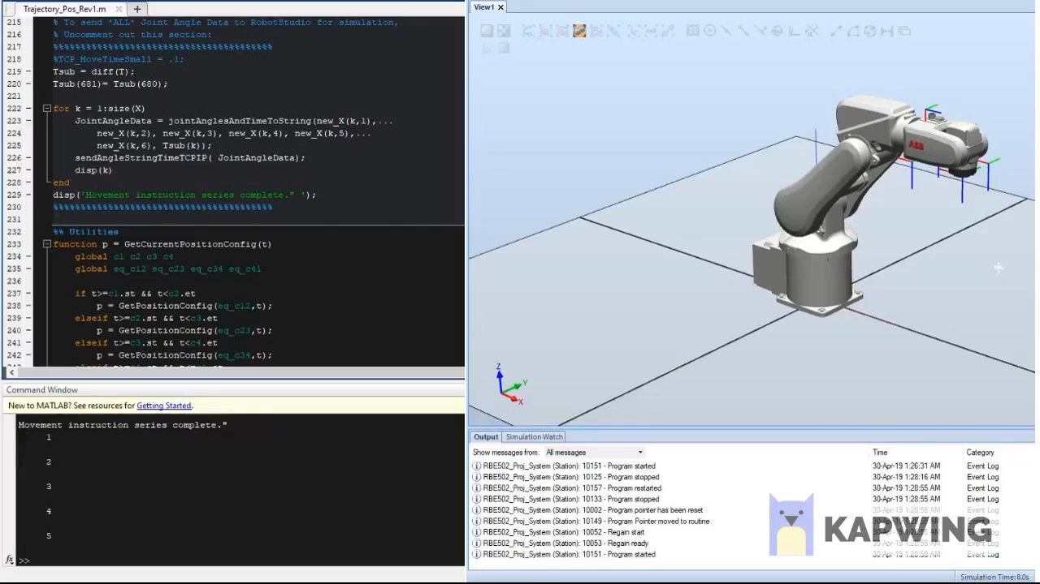
REsults
Notes:
This slide provides a video demonstrating our simulation results. The MATLAB script is executed and at the same time, the RobotStudio RAPID program is run. The MATLAB script completes its calculation of the joint angles using the ODE45 solver. It then connects to RobotStudio using TCPIP and sends all the joint data. Once all the joint data is received, the virtual controller in RobotStudio executes the joint movement commands. As we can see, the end-effector traces out the near perfect rectangle, as was calculated in MATLAB. It correctly takes 5 seconds to travel between each corner, with a total travel time of 20 seconds. We also see that the velocity slows to 0 at each corner.This verifies our Control solution as well as our ability to communicate with RobotStudio.

Slide 13
Conclusion
Successfully solved and verified the Kinematics, Dynamics of the Robot.
Closed the loop with Computed Torque Control Law.
Successfully matched the desired trajectory.
Successfully established communication between MATLAB and RobotStudio.
Simulated the ABB IRB 120 robot following the trajectory in RobotStudio.
Notes:
In Conclusion, we successfully solved and verified the Kinematics and Dynamics of the Robot, “closed the loop” with our Computed Torque Control Law, successfully demonstrated our solution matched the desired trajectory, successfully established communication between MATLAB and RobotStudio, and successfully simulated the IRB 120 following our instructed trajectory in RobotStudio.

Slide 14
References
https://www.mathworks.com/help/robotics/ug/robot-dynamics.html
https://www.mathworks.com/help/robotics/ref/robotics.rigidbodytree.forwarddynamics.html
https://www.mathworks.com/help/robotics/ref/robotics.rigidbodytree.inversedynamics.html
https://www.mathworks.com/help/robotics/ref/robotics.rigidbodytree.massmatrix.html
Notes:
Please refer to the links shown for our applied Robotics System Toolbox functions in our solution.

Slide 15
THANK YOU
Notes:
Thank you for your time and attention.

